Slide 1
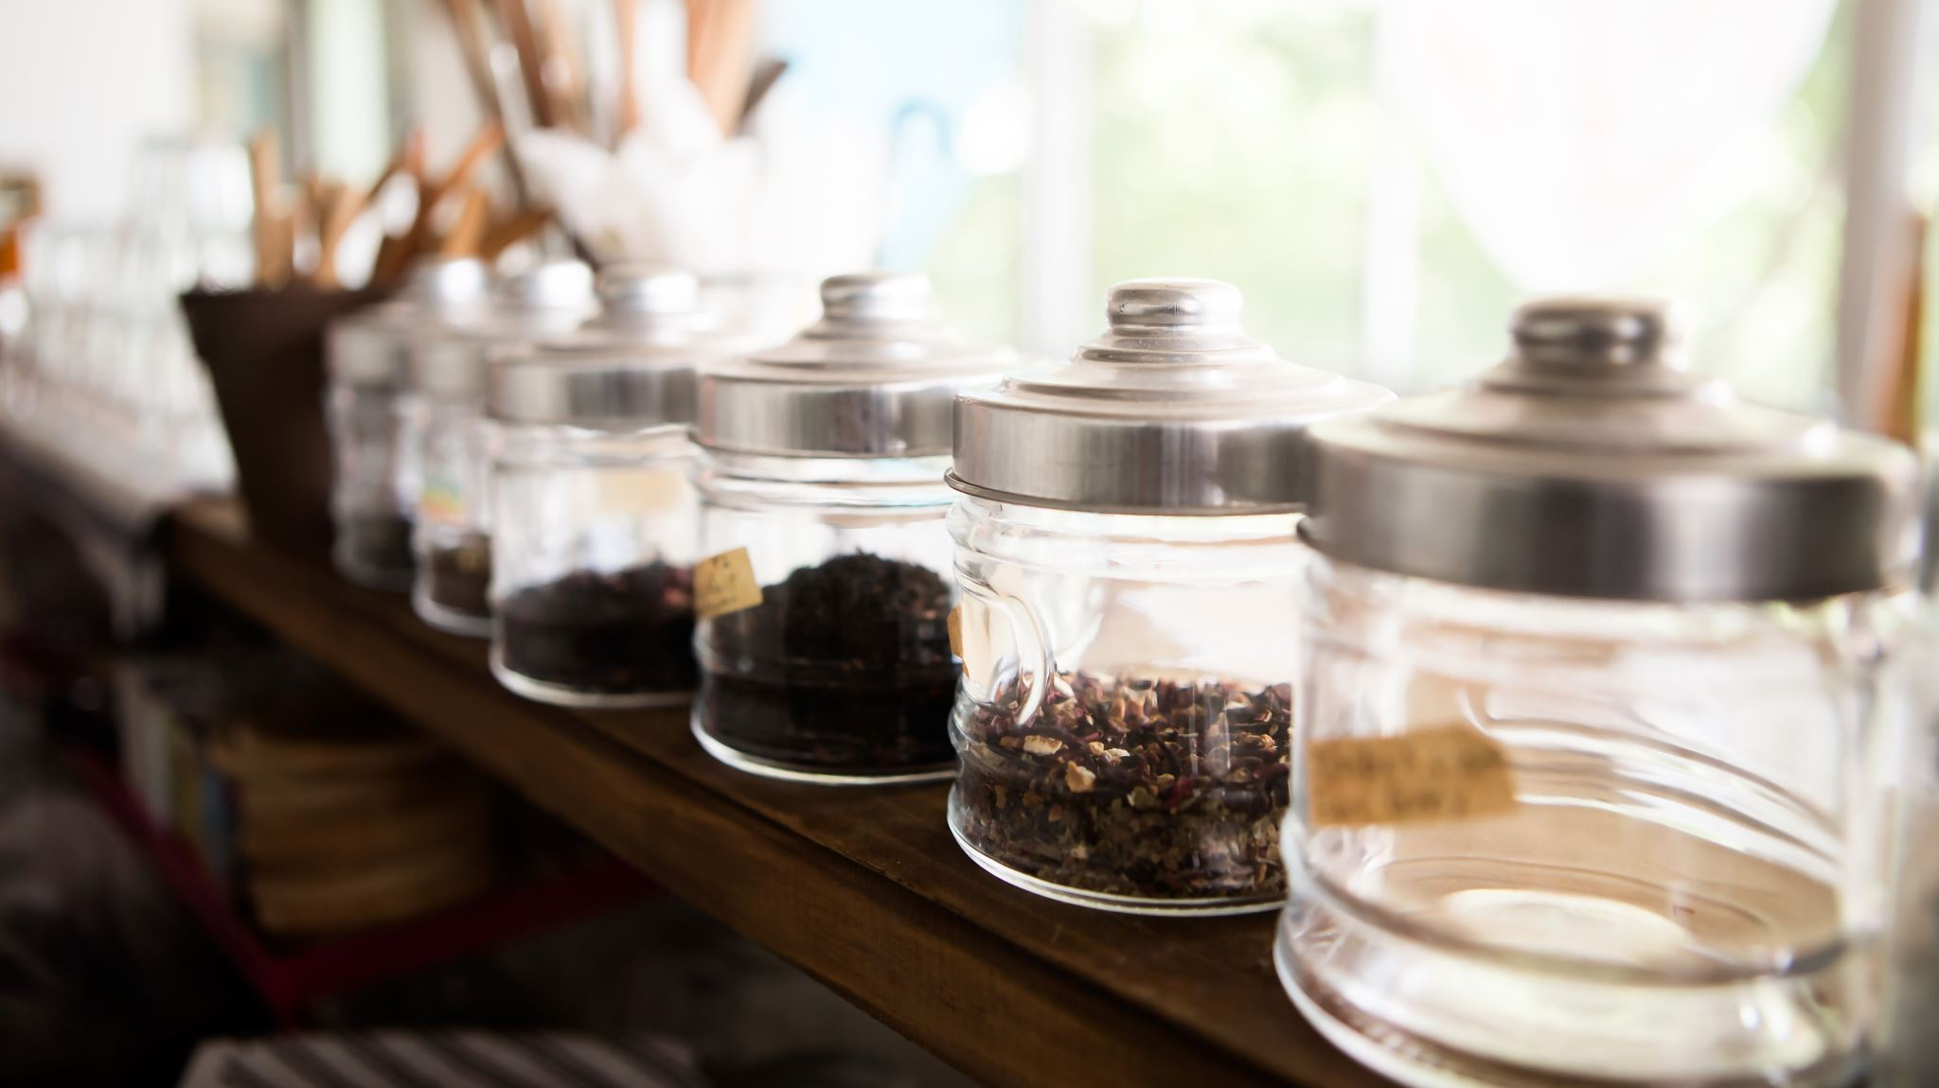
Opening a Coffee Shop
WITH SOME HELP FROM the Foursquare API and Python

Slide 2
Opening a Coffee Shop is Hard
Opening any new business is hard, and with so many competitors a new coffee shop can struggle to get on its feet if it is not well located.
Identifying the right place is especially hard in New York City because there are so many different types of shops and restaurants in such a dense environment.
Fortunately with the right data and some close analysis we can narrow down the candidate neighborhoods to improve the chances for success.

Slide 3
Zooming in on Manhattan
Manhattan is one of the largest, busiest and most varied boroughs in New York City, so we will be focusing in on it.

Slide 4
Data Acquisition and Cleaning
Firstly we use the lab’s NYC borough and neighborhood data to make a JSON call to Foursquare and get venue data for each neighborhood.
This data is then formatted and cleaned and put into a pandas dataframe.
From here we can analyze the venue frequency for each neighorhood.

Slide 5
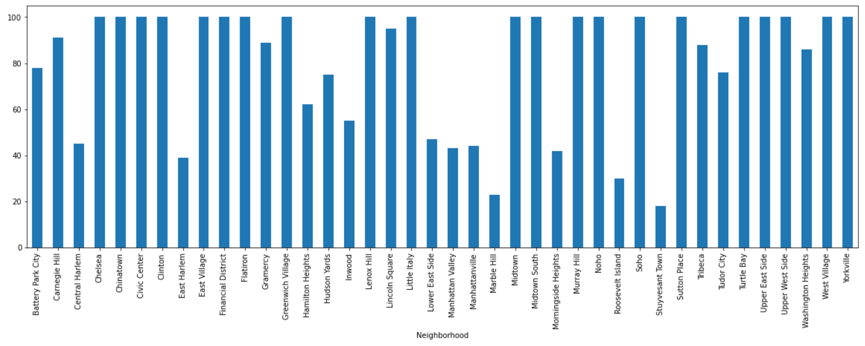
Which neighborhoods have the most venues?
A chart showing the number of venues returned by foursquare for each neighborhood.
**note that due to a foursquare API limitation, the number returned maxes out at 100 venues

Slide 6
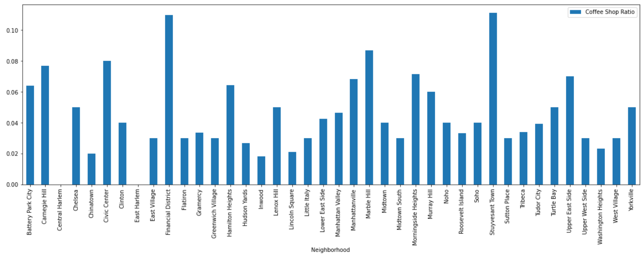
How many coffee shops are already serving?
A chart showing percentage of venues that are coffee shops.

Slide 7
Identifying the most underserved neighborhood.
Central Harlem and East Harlem have no coffee shops!
However these neighborhoods have among the smallest number of other venues and may not generate much business overall.
Chinatown has many other venues but also has a small number of coffee shops—only 2%--and looks like a good place to start up a new shop.

Slide 8
Other considerations
There are of course many other considerations to where to start a new coffee shop,
including, but not limited to:
Rent
Building availability
Population type (office workers vs apartment dwellers)
Local tastes (perhaps Chinatown appears to be underserved because everybody there drinks tea instead of coffee)

